Slide 1

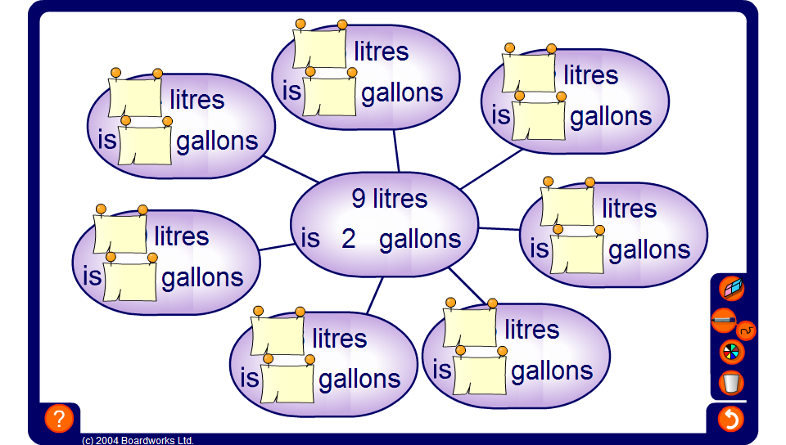


Spider diagram
Notes:
Link:
N8 Ratio and Proportion – direct proportion.

